Slide 1
MATRIX MANIPULATION

Slide 2
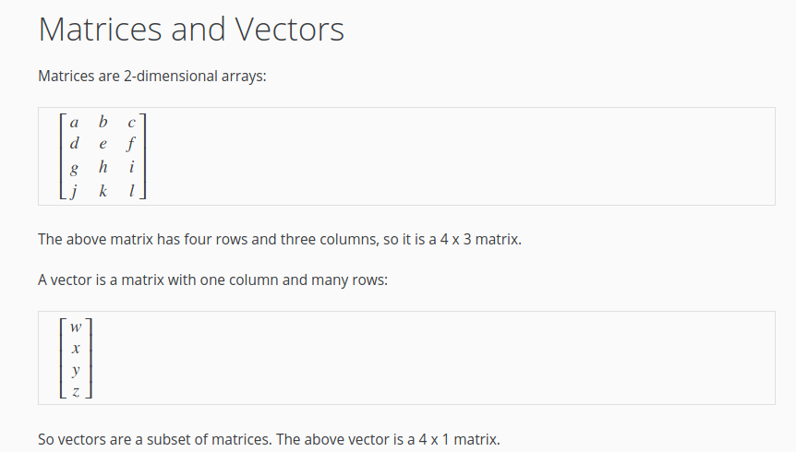
MATRICES AND VECTOR

Slide 3
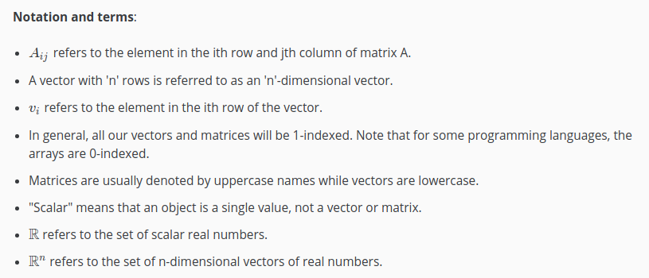
Notation

Slide 4
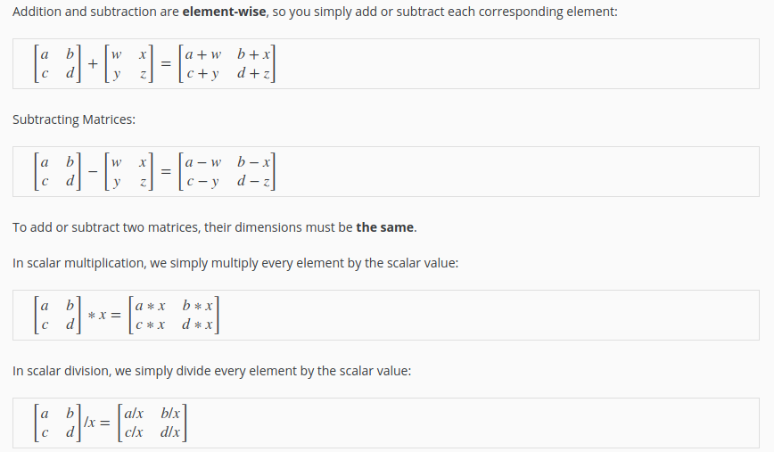
Addition and Scalar Multiplication

Slide 5
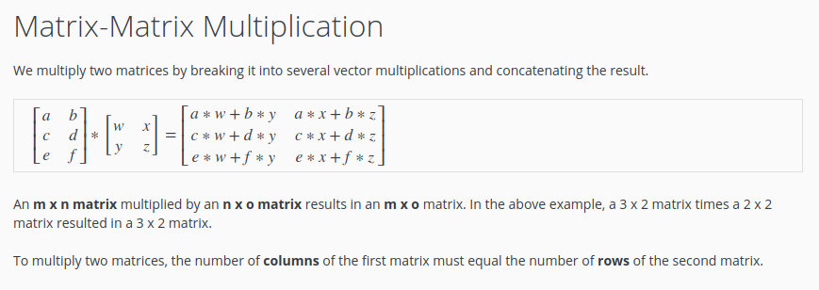
Matrix Multiplication

Slide 6
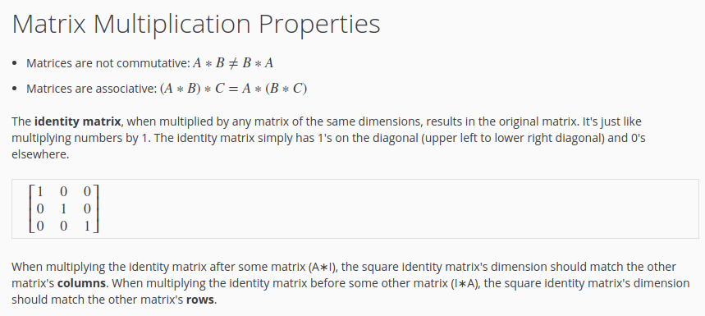
Matrix Multiplication

Slide 7
NUMPY LIBRARY
numpy_tutorial.ipynb

